Slide 1
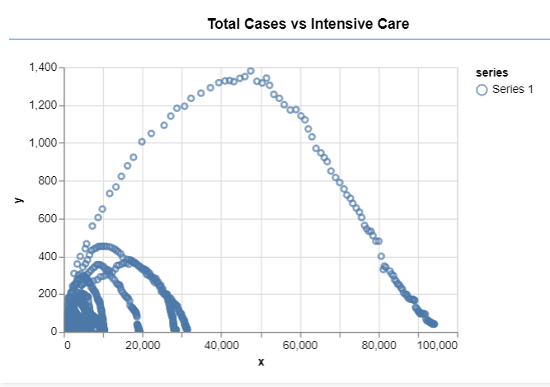
We have import historical corona pandemic data of Italy.
getDataFunction: Fetches data from API ( our case hosted data files on Github).
CreateModelFunction: Here we can see distribution of totalCases.
Sequential() function is used to create a placeholder for our model.
We have built 3 layer neural network with 10 epoch.
Activation function for first layer is “tanh”, for second one “relu” and for third one “softmax”.
Then we trained our neural network with actual data.
We have used Tensorflow.js for ML in JS that is why we can see results in Browser.
In order to use our model; First insert data source under readDataFunction, then under showDataFunction you can specify required datas for x and y axis.
Model link: https://raw.githubusercontent.com/furkanacundas/COVAID_20/master/covid-19-Italy-prediction.js
Data Link: https://raw.githubusercontent.com/furkanacundas/COVAID_20/master/covid19-italy-region-beds.json

Slide 2
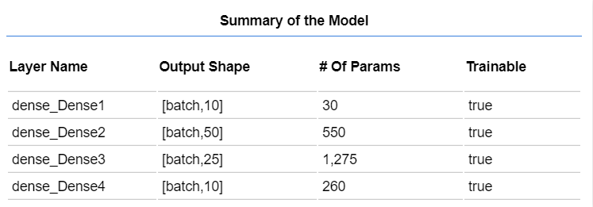
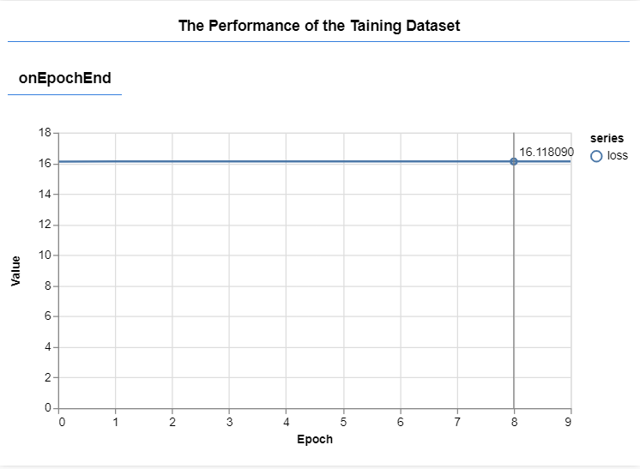
We used sequential to create a placeholder for our model. This way we can add different layers into it.
Then we add layers of densely connected neurons by utilizing dense.
In the first call, we create one hidden layer of 50 neurons, with an input layer of 11 neurons.
We have 11 inputs because in our dataset we have 11 features. Then we add an additional two hidden layers with 30 and 20 neurons respectively.
Finally, our output layer is having 10 neurons, because we have 10 possible categories of Covid-19 Italy data.
Once again, you can notice that TensorFlow.js kept the API that is similar to the TensorFlow API in Python. We compile our model with Adam optimizer and categorical cross entropy.
Then we run the training process with fit method call. This process is visualized.

